Slide 1

BISHOP PERRIN CoE PRIMARY SCHOOL
September 2026– Welcome to the new school year
Our vision is that we will grow in the God-given virtues of “faith, hope and love” (1 Corinthians 13:13): having faith in God or being inspired by faith; having hope that we can work to change ourselves and the world for the better; and having love for others, reflecting God’s love for everyone.
Celebrating learning together in faith, hope and love

Slide 2
Senior Leadership Team
Headteacher – Miss Rachael Macklearn
Deputy Headteacher – Miss Mary McAvoy
Assistant Headteacher – Miss Jo Sweeney
Staff Team
Support Staff
Mrs Mia, Mrs Kelly, Mrs Vanstone, Mrs Hussein, Mrs Lambrias, Miss Kaill, Miss Poole, Ms. Vu
Operations Team
HR Officer – Mrs Ivy Sy
Finance and Admin Officer – Miss Jess De Boissiere
Marketing and Admissions – Mrs Jemma Chawla
Facilities and Site Manager – Mr Tom Murray
Kitchen team: Vicky, Sarah-Jane, Valentina
Cleaners – Sarah and Cody
IT Support: Click On It
Class Teachers
Reception – Miss Rachel Lawrence
Year 1 – Mrs Avril Beith, Mrs Elise Lawton (Fri)
Year 2 – Miss Ruth Lancaster (Mon – Wed) and Mrs Jacqui Place (Thurs and Fri)
Year 3 – Miss Jessica Gunter
Year 4 – Miss Jo Sweeney and Mrs Sarah English (Fri)
Year 5 – Miss Derri Murray
Year 6 – Mrs Amanda Crinall (Senior Teacher) and Mrs Sarah English (Mon)
Additional Teaching Staff
Intervention teacher – Mrs Davidain
Spanish teacher - Mrs Anthia Poleviou
JA Sports Coach – Miss Isla Cousins
Welfare Team
Mrs Sandell, Ms. Raihan Ruslan

Slide 3
Safe-guarding and wellbeing
Our children’s safety is a key priority and at the forefront of our work at school. Our staff are all comprehensively trained and receive regular training updates to be aware of the latest issues and concerns around signs of safety. We take all safeguarding disclosures seriously and will follow our safeguarding policies to address them. We will be proactive in escalating concerns where necessary to keep our children safe from harm. There may be times when we contact you because of a disclosure at school – please always know that we are asking these questions and taking this action in the best interests of the child.
Children’s wellbeing is also an essential part of our provision. It is increasingly important that we work collaboratively to equip children with the tools they need in their own lives to achieve success. School life offers many opportunities for children to succeed – through friendships, through play, through sport, in academic achievement, in performance. We will work hard to make sure children are safe, healthy, enjoy and achieve, and are equipped to make an economic and positive contribution. Your children’s class teachers and the staff who work with them will be mindful of each child’s feelings and work with them and you, to support them in times of difficulty.

Slide 4
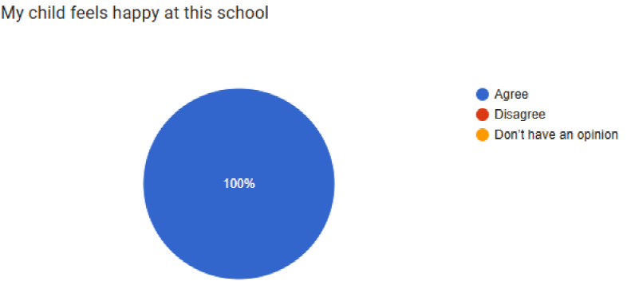
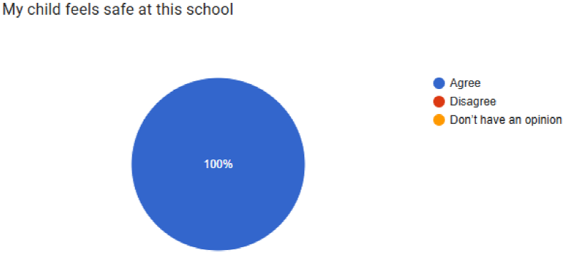
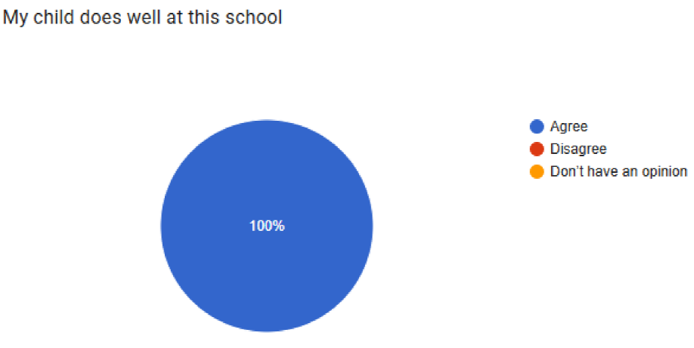
What have we achieved in the past year?
Improved attendance: 96.96%
(DfE target: 96.2%)
EYFS GLD: 81%
Phonics check: 90%
Multiplication check av.: 22.9/25, 40% achieved 25/25; 67% achieved 20+
Rights Respecting School Bronze Award
Attachment Aware Bronze Award
Y6 SATs 2026 | Reading |  | Writing |  | GPS |  | Maths |  | Combined
Standard | EXS | GDS | EXS | GDS | EXS | GDS | EXS | GDS | EXS | GDS
School | 83% | 43% | 80% | 17% | 90% | 43% | 93% | 33% | 73% | 7%
National | 75% | TBC | 73% | 13% | 74% | TBC | 75% | TBC | 63% | 8%
I couldn't have chosen a better school for my son. Each year, I have seen him grow from strength to strength. He has overcome some significant personal challenges, and much of this is due to the unwavering support, encouragement, and guidance provided by the school and its teachers throughout his journey. I am incredibly grateful for the positive impact the school has had on his development, both academically and personally – parent survey, June 2026

Slide 5
Recent Developments
School’s 90th anniversary
Development of Spirituality
Successful financial audit
Updated systems – Google School
Site developments – new windows, new roof (Year 3), playground enhancement
Parkrun Primary
Successful year of SA events
New extra-curricular clubs

Slide 6
Key priorities for 2026 - 27
Health, safety and wellbeing
Inclusion
Implications of Curriculum Review
Use of AI
OFSTED 2028
School budget and finance

Slide 7
Curriculum Statement
Inspired by our local community and surroundings, our curriculum at Bishop Perrin School is designed to nurture life-long learners and provide opportunities for all to succeed in the modern world with confidence, creativity and curiosity. We endeavour to instil a love of learning using a range of exciting and inspiring books as a gateway to a wide range of subjects and cultural and social experiences. We aim to provide opportunities for all pupils to learn the knowledge, understanding and interpersonal skills necessary to be active, healthy, responsible participants in their community and the wider world, providing stable foundations for the next stage in their learning. Our curriculum is underpinned by our school’s spiritual values.
You can find all the details of what your child will be learning each term by visiting the learning page of our school website and clicking on curriculum.

Slide 8
Children read and are read to every day and have plenty of access to stories and books throughout the school day.
Children will have a reading practise book (book bands) which will be their weekly reading homework. This is an online book in Reception, Year 1 and beginning of Year 2, moving to physical books from Year 2 when children move on from the Little Wandle phonics reading scheme. Parents are advised to support their children to read their practice books little and often. Starting with 5 minutes daily in Reception, increasing to 5 – 10 minutes daily in KS2, 10 – 20 minutes daily in KS2. Focus is on accuracy of reading to develop fluency.
They will also have a ‘reading for pleasure’ book from the library. This is a book of their choice and is designed to be read to them by an adult or read independently to encourage an enjoyment of reading.
All classes visit the school library every week, and Whitton library once a term.
Reading is at the heart of our curriculum
The single biggest predictor of high academic achievement is reading to children every day.

Slide 9
INCLUSION
We are an inclusive school and work hard to foster a sense of belonging for everyone in the school community.
Our size of school means that all the children are well known to staff and each other and we are able to respond to the needs and interests of our children.
Our curriculum has been carefully designed to represent our school community and to broaden children’s horizons. We support families in need and children who are experiencing challenges, both in the short and longer term. Children with special educational needs and disabilities are supported to make progress at a pace suitable to them and we work collaboratively with you to prepare them for the next stages of their education.
We celebrate diversity and are always looking for ways to develop our offer to represent the school community and children’s life experiences. Our staff engage actively in continued professional development and work alongside outside agencies such as therapists, speech and language, social care and health workers to do the best for each child.

Slide 10
Attendance
The good news… 96.96% 2025 / 26 (surpassed DfE target of 96.5%). This represents 210 more days of school attendance than last year, this equates to over a whole school years’ worth of extra days our pupils were in school.
What are the main issues? holidays taken during term time; ad-hoc days off when the child is well enough to come to school
What are some of the other reasons? A child not wanting to come to school; anxieties
Attendance – why is it important for my child to be in school everyday?
Avoid lost learning – helps to school to provide support for your child to keep up, rather than have to catch up.
Life lessons – responsibilities; being on time; respect for other people’s time; preparation for secondary school and responsibilities of working
Potential impact on friendships and missing out on experiencing wider curriculum events
OFTSED judge schools on poor attendance – we all play our part in achieving positive OFSTED judgements

Slide 11
365 DAYS A YEAR | 175 NON-SCHOOL DAYS A YEAR 175 days to spend on family time, visits, holidays and other appointments
 | 190 SCHOOL DAYS IN EACH YEAR 190 days for your child’s education | 10 days absence | 20 days absence | 29 days absence Half a term missed | 38 days absence | 47 days absence, over two months missed
 |  | 180 DAYS OF SCHOOL
 |  |  | 170 DAYS OF SCHOOL
 |  |  |  | 161 DAYS OF SCHOOL
 |  |  |  |  | 152 DAYS OF SCHOOL
 |  |  |  |  |  | 143 DAYS OF SCHOOL
 | 100% | 95% | 90% | 85% | 80% | 75%
 | GOOD | MONITORING | WORRYING |  | SERIOUS CONCERN

Slide 12
How is my child doing?
• Parent interviews: the school offers two formal opportunities for parents to meet with their child’s class teacher for a 10 minute meeting, once in the autumn term and once in the spring term.
• Appointments: in addition to the two formal parent interview meetings, parents are able to make appointments to see members of Bishop Perrin School staff at any time if they want to discuss any aspect of their child’s education and performance at school
• Informal chat with class teacher: parents are often able to have an informal chat with their child’s class teacher at the end of the school day when the children are dismissed
• End-of-year reports: in the summer term parents receive a written report detailing how their child has performed over the course of the academic year.

Slide 13
How does the school communicate with parents?
You can discover all the ways in which the school communicates with parents and how you can communicate with us, by reading our Communications Policy. These include:
Email: this includes sending out the weekly newsletter on Friday, and for reminders and updates about other aspects of school life
School website (www.bishopperrin.richmond.sch.uk ): a one-stop-shop to find out everything about the school and your child’s learning, including a calendar which is populated with upcoming events and activities.
Social media: our Instagram account keeps parents updated on day-today life and learning at Bishop Perrin School. Posts on our social media accounts are for information only and the school does not respond to comments or postings put on the account.
Parent forum: termly meetings with the parent Forum Class Reps and the headteacher in which issues pertinent to the parent community can be raised and discussed

Slide 14
How do I discuss any concerns with the school?
It is always our desire to resolve any concerns or issues you may have regarding your child’s experience at school, as quickly and as smoothly as possible. Your first point of contact for any concerns you have about your child will usually be your child’s class teacher.
Informal chat or phone call discussion: parents can phone the school and speak to the appropriate member of staff or catch them in the playground at the end of the day with the aim of making the teacher aware of the problem and finding ways to resolve the concern as quickly as possible. If this isn’t possible, please send a brief email highlighting the issue you’d like to bring to their attention.
Request a meeting: if an issue is of a more serious nature, parents can request an appointment for a face-to-face meeting with their child’s class teacher, to meet with the school’s Inclusion Leader (who deals with special educational needs) or someone from the Senior Leadership Team.
3) Complaint: If a matter cannot be resolved by either of the methods above and needs to be escalated, parents can submit a formal complaint, following the steps laid out in our complaints policy which is available on our school website
We politely ask that parents follow the systems set out in the school’s Complaints Policy and Communications Policy for dealing with any concerns or grievances.

Slide 15
Respectful Communications
When communicating with Bishop Perrin School, we ask parents and carers to accept that their child’s reporting of an event is but one piece of the puzzle, with school staff having further information available to them through multiple staff and student perspectives.
We ask that parents take a curious, rather than accusatory, approach in the initial stages of a concern to find out more about what has happened. We ask parents to set a good example to their children in their own speech and behaviour and refrain from criticising members of staff in front of their child.
We ask that parents accept that decisions made by staff are based on a body of evidence and on the balance of probability and take into consideration that staff may be faced with dilemmas involving ambiguity.
We ask that parents are mindful of posts or comments made on social media regarding the school or any members of the school staff. This includes posts in parent Whatsapp groups. Comments that could be considered abusive towards staff, harmful to their professional reputation or of a bullying nature will not be tolerated and legal advice will be sought as to how to proceed in these circumstances.
For further guidance about how to raise a concern or complaint, please see this guidance produced by Parentkind, OFSTED and the DfE which is published on our website.

Slide 16
AI-generated communications to raise concerns / complaints
We follow school policies when dealing with and responding to a concern or a complaint.
Please be mindful of using AI to generate or enhance an email to raise your concern / complaint. Whilst we recognise that AI can be a helpful tool for those for whom English is not their first language, AI will often produce unnecessarily lengthy and over-complicated communications that take a long time to unpick, which can cause delays in response time and unnecessary workload for staff. It may include mistakes such as quoting wrong legislation or setting out demands and response times that the school is not obliged to adhere to. It may base a response on information it has drawn from the internet that is not applicable to Bishop Perrin School.
Parents must also be mindful of confidentiality and data protection issues regarding the school and it’s community when inputting information to an AI programme. Redaction of names is not always enough to avoid data leaks.
This is not to say concerns or complaints should not be raised, they absolutely should as this is how we learn lessons, adapt and make changes for the better. However, we will respond to your concern whether you raise your concern in person, over the phone, in person or in your own-worded email. We understand that the matter is important to you; we understand that is has caused upset or concern, we will listen and investigate and seek to resolve the issue.
Please support us to do this in the most efficient manner possible for the benefit of everyone involved.

Slide 17
Instead of AI, consider using these phrases instead to help structure raising a concern with the school…
I was wondering…
We’ve noticed / heard…
What are you seeing…?
How can we support…?
Positive relationships with the school maintained, perhaps even strengthened

Slide 18
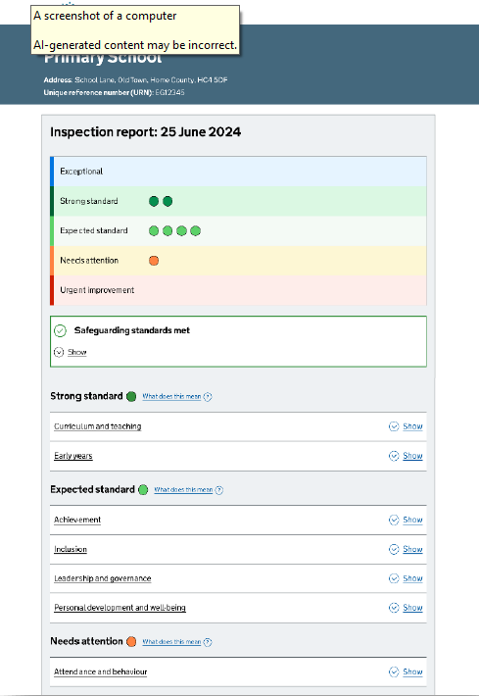
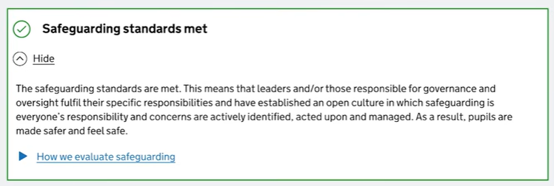
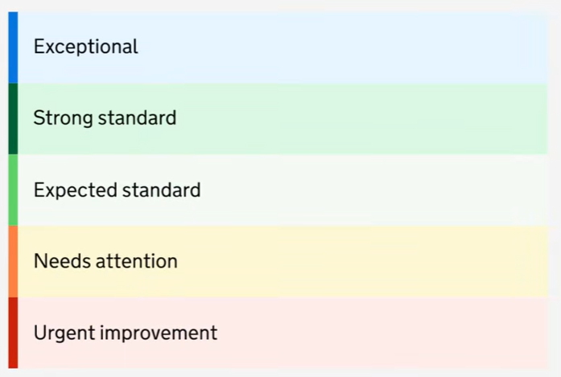
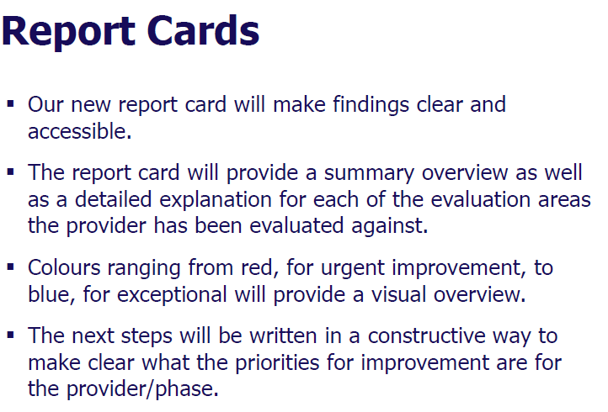
New OFSTED framework - a different approach to inspection

Slide 19
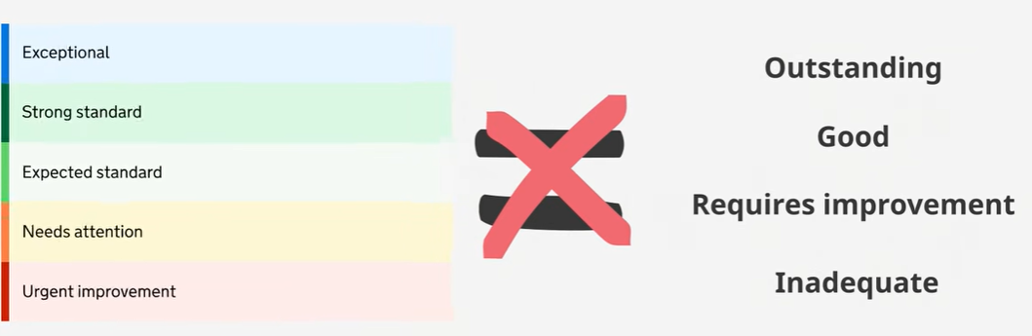
A different approach to inspection
Expected standard is just that – it means the school is doing everything that it should be doing so you would see the green colour-coding on the report card. It’s a high standard to make sure your children are receiving everything they need and deserve.

Slide 20
Mobile phones in school
Mobile phones and smart watches for children are not allowed in school. This has been school policy since September 2025.
Following the recent publication of the government ‘Mobile Phones in Schools’ guidance schools must now be mobile phone-free environments, and it is for headteachers to decide how best to achieve this within their own unique contexts. Our policy still stands that mobile phones and smart watches for children are not allowed in school.
Exemptions: We understand that when children are walking to and from school, it may be reassuring for them to have a mobile phone with them. Therefore, the school allows an exemption to this policy for children in Year 5 and 6 who are on the walk to school / walk home register. They may bring a non-smartphone mobile phone to school but it is entirely at their own risk. This must not be a smartphone. Alternatively, children can bring a tracker to school, but this must adhere with the stipulations set out in our school communications policy (please note: trackers are NOT allowed on school trips or residential visits). In exceptional circumstances, for example, when the technology on a smart device is required to monitor a health condition or support a specific need for a child with an EHCP, it may be that a smartphone is permitted in school. This is decided on a case-by-case basis and will be recoded on the child’s Individual Health Plan or Learning Support Plan. Under any of these exemption circumstances, children choose to bring a phone to school at their own risk. The school does not accept any responsibility for any damaged / lost / stolen phones when they are on school property.
Maintaining a mobile-free environment: Where these exemptions are in place, children’s phones must be turned off on arrival at school and they must hand them into the office before walking down the alleyway to their class. The phone will be locked away for the duration of the day and returned to children on the playground at the end of the day. It is the child’s responsibility to make sure that they have their phone before they leave school at the end of the day. Please ensure your child’s phone is named.
Consequences: Government guidance states a mobile phone for pupils in school during the school day is a prohibited item. In the event that a pupil chooses not to follow the rules and brings a smartphone / smartwatch or mobile phone into school this will be managed in line with our school Behaviour Policy. This policy states that staff are permitted to conduct a search for prohibited items and therefore can search for a mobile phone if it is suspected that a pupil has one in school. If a pupil has a mobile phone in school it will be confiscated for whatever time the Headteacher considers to be proportionate. Additionally, they will no longer be permitted to bring a mobile phone into school at all. The school’s behaviour policy will be strictly adhered to at all times.
Parents have an important role in supporting the school’s policy on prohibiting the use of mobile phones in school. Please reinforce and discuss this at home as appropriate, including the risks associated with mobile phone use and the benefits of a mobile phone-free environment.

Slide 21
Why are smartphones banned for children at Bishop Perrin School?
In 2024 / 25, the decision was taken to ban smartphones and smartwatches for children on the school premises. This decision was taken with the children’s best interests at heart. It was discussed at the Parent Forum, and communicated to parents in February 2025, with it becoming policy in September 2025. This policy has not changed.
The rationale behind this ban:
The school does not endorse or encourage the use of smartphones for children of primary school age based on a wealth of research and our experience of dealing with increasingly significant behaviour, wellbeing and safeguarding issues that originate from a child’s smartphone use. Often, these issues are a direct result of children being too young to handle the responsibility and the consequences of online behaviour via these devices. We were also advised by our Community Police Officer that use of smartphones can make children more vulnerable to harm, potentially at an increased risk of theft or mugging, or perhaps too engrossed in their phone to maintain safe walking / road safety.
It is a supportive measure for parents, many of whom have shared that they would prefer not to give their child a smartphone at primary age, but found this difficult to maintain as a result of peer pressure. A collective approach to delaying children having smartphones at primary school can help parents to manage these decisions.
Smartphones and smartwatches are expensive and valuable devices, and allowing these devices on school premises poses significant issues for the School regarding liability for their loss or damage. Consideration was given to the significant amount of time that would be required to manage the consequences of this happening.
The School is not able to make distinctions between smartphones which have some applications disabled and those which do not and are not in a position to check this.
For further information about some of the training we have facilitated for parents and further understanding of the rationale behind this decision, please see these resources shared by Ellen Collins, Deputy Headteacher at Turing House, who led the training about the impact of smartphone use on young people and children.

Slide 22

Swimming lessons – Isleworth Leisure Centre
Term Dates | Swimming Start date | Swimming End date | Exclusion Dates | Total weeks
Autumn Term YEAR 3 | 21st September | 30th November | Half term: 26 – 30th October 2026 | 10 weeks
Spring Term Some Y4, 5 & 6 pupils | 11th January | 22nd March | Half term: 15/02/2027 – 19/02/2027 | 10 weeks
Swimming kit
Plain-coloured swimsuit / trunks (ideally black) School (or plain yellow) swimming cap (available from school only) Children can wear their PE kit to school on their swimming day.
Autumn term - Monday mornings
9:30 – 10:00 – Year 3
Spring term
9:30 – 10:00 – Year 4, 5 & 6 children who have yet to meet level 5
Travel to and from leisure centre by coach.

Slide 23
Key Dates
Clubs start: Monday 14th September
Phonics workshop for parents: Tuesday 22nd September
INSET Day: Friday 4th December
Class assemblies
5th November – Year 6
28th January – Year 3
25th February – Year 4
11th March – Year 2
29th April – Year 1
27th May – Year 5
1st July - Year R
Class assemblies will be on Thursdays in the school hall at 8:55am. Parents and carers are welcome to attend. Please refrain from bringing drinks and snacks into the school hall during the assembly to help us manage food allergies – thank you.
Nativity Performance – Year 1 & 2
Wednesday 16th December – 9am and 2pm
Reception Carol Performance
Tuesday 15th December – 2.30pm
Christmas Carol Service – last day of term
St. Augustine’s Church – Friday 18th December, 12:30pm (TBC)
Early finish: 2pm
Parent Consultations
Autumn Term | Spring Term
Wednesday 14th October – 3.30 – 7pm Thursday 15th October – 2.30 – 6pm (early finish @2pm) | Wednesday 20th January – 3.30 – 7pm Thursday 21st January – 2.30 – 6pm (early finish @2pm)

Slide 24
How can I get involved in school life?
The School Association (SA): the SA are a vital part of our school community and organise activities and events to raise money to help the school. Helping with the SA allows parents to bring their skills and experience to assist with planning and the organisation of events whilst also getting to meet other parents across the school.
The Governing Board: the school is overseen at a strategic level by a board of governors, who are volunteers and are made up of members of the school community. We have space for two parent governors on the governing board who hold a term of office for four years.
The Parent Forum: It aims to meet once a term with the headteacher to discuss ideas and initiatives to help develop and foster good relationships between the school and the parent body. Each class can have up to two representatives on the parent forum who act as conduits to discuss aspects of school life and organisation that come to light. Please see the Parent Forum page on the school website, which includes the Terms of Reference and the Minutes from previous meetings. We currently have a vacancy for someone to Chair our parent forum.

Slide 25
Volunteers
Volunteers play a valuable role in supporting children with their learning and facilitating wider school experiences. We warmly welcome you to offer your support in whichever way you can.
Some of the ways you can get involved in school life:
Volunteer in class – please contact your child’s class teacher directly to discuss ways in which you can help and to arrange a suitable time to come in
Contact the school office to volunteer as a weekly volunteer to help with children across KS2 with their reading or practising their times tables
Volunteer your time with the School Association. Go along and see what they have planned for the year and how you can help.
Volunteer to help on a school visit. Some up-coming visits for Year ? include …. Please let your child’s class teacher know if you would like to accompany the class on these visits.
Volunteer to help to walk to church / library with your child’s class.
Anyone who volunteers more than 3 times in 30 days will require a DBS check

Slide 26
THANK YOU
Meet the Teacher
Year 4 & 5: Monday 14th September, 3:30 – 4pm
Year 3 & 6: Tuesday 15th September, 3:30 – 4pm
Year 2: Wednesday 16th September, 3:30 – 4pm

