Slide 1

BISHOP PERRIN PRIMARY SCHOOL
Celebrating learning together in faith, hope and love
Year 3 PARENT INFORMATION MEETING
September 2025

Slide 2
School Vision
Our vision is that we will grow in the God-given virtues of “faith, hope and love” (1 Corinthians 13:13): having faith in God or being inspired by faith; having hope that we can work to change ourselves and the world for the better; and having love for others, reflecting God’s love for everyone.
Through our love for God, we know that we are all unique and special. We have love for ourselves and for one another, and under God’s guidance we demonstrate that love is an active behaviour. We create a sense of belonging for everyone in our school community; living well together and celebrating our diversity in a safe and supportive environment. We treat everyone with respect; encouraging kind, loving and inclusive behaviours. We love to learn through a rich and varied curriculum designed to develop enthusiastic and inquisitive learners in a culture in which everyone is encouraged to achieve their highest standards and have the confidence to face challenges.
We have faith in ourselves and one another. We have faith in God or are inspired by faith. We explore the Bible in collective worship and RE lessons and children are invited to consider what they can learn from this and how it may impact their daily lives. We develop an understanding and respect for people of all faiths and none and everyone is encouraged to grow in their faith.
We believe that through the love of God we have hope for the collective good of society. We work in partnership with each other, families and the wider community to achieve wellbeing and success for all. We endeavour to improve the world we live in through our charity work and service to the community. We believe that we can be the agents for change in the hope for a brighter future for ourselves and each other, and we encourage children to become responsible and independent global citizens. We develop an understanding of the Christian belief that we are part of a bigger existence beyond this world: that eternal life is hope for the future.

Slide 3
Curriculum Statement
Inspired by our local community and surroundings, our curriculum at Bishop Perrin School is designed to nurture life-long learners and provide opportunities for all to succeed in the modern world with confidence, creativity and curiosity. We endeavour to instil a love of learning using a range of exciting and inspiring books as a gateway to a wide range of subjects and cultural and social experiences. We aim to provide opportunities for all pupils to learn the knowledge, understanding and interpersonal skills necessary to be active, healthy, responsible participants in their community and the wider world, providing stable foundations for the next stage in their learning. Our curriculum is underpinned by our school’s spiritual values.

Slide 4
We value the support from parents and the partnership between home and school which ensures that children are able to be the best they can during their time at Bishop Perrin School. This meeting is designed to assist your child and the smooth running and work of the school throughout this academic year, and supports our Home School Agreement.
Further information is available on our school website: https://www.bishopperrin.richmond.sch.uk/
Please follow us on our instagram account where you can keep up-to-date with the latest goings-on at school. Follow us on: @bishopperrinschool

Slide 5
Attendance
Your child should be in school every day unless they are unwell. The school must be informed of any absence.
Holidays during term time are not permitted and are strongly discouraged. Whilst we understand the challenges facing families regarding cost of holidays, term-time holidays are very disruptive for children in school and result in a significant loss of learning. Term-time holidays will be recorded as an unauthorised absence and may be subject to a fine.
Children are awarded certificates at the end of each term for excellent attendance – 98% or above with no unauthorised absences.
Pick up at the end of the day
Pick up time is at 3:15pm, from the playground. Please ensure we have written permission for any adults who you allow to pick your child up from school at the end of the day. If your child is to be collected by someone other than the adults you have already authorised, please inform the school in writing.
We do not allow older siblings to pick up our younger children from school. For children in Year 3 and below, the person picking up must be 16 years or older.
Punctuality
It is imperative that your child arrives at school on time to support a settled and smooth transition to the start of the school day.
The front gate will be open from 8:30am until 8:40am. Your child is expected to arrive at school before the gate closes.
If your child arrives after 8:40am, please bring them to the main entrance and sign them in using the electronic register.

Slide 6
Adherence to the school uniform policy is greatly appreciated in ensuring we maintain a smart and unified approach to school uniform.
All children should be smartly dressed in the school uniform – the policy is available on the school website. Children are expected to wear school shoes, not trainers.
All items must be clearly named.
PE Kit
Children will come to school wearing their PE kit. At the moment, this will be on Monday and Friday. If your child is wearing trainers that have laces for PE, please help them learn how to tie them independently.
Outer wear
School fleece or a dark-coloured coat. Hats and scarves must be plain and dark in colour.
Accessories
Jewellery is not permitted, except for a simple pair of stud earrings for children who have pierced ears, and a wrist watch. Fit bits are permitted, but no other smart watch devices in-line with our online safety policy. Mobile phones are not permitted in school for children in Years R - 4.
Water bottles
Children are encouraged to bring a small, plastic water bottle into school. Only water is permitted for drinking in school. Please do not send metal water bottles or over-sized / expensive water bottles. Water bottles MUST be named. This is not just to help identify who the bottle belongs to, but is also a strategy for managing risk involving food allergies.
School Uniform

Slide 7
Teachers regularly assess children’s reading to ensure that they are reading at the correct level.
Children will bring home their reading practise book (book bands) which will be their weekly reading homework. These readings should be recorded in their homework diary, along with a note of any challenging vocabulary. Children should be heard read at home by an adult or older sibling at least five times a week for about 10 minutes each time.
They will also have a ‘reading for pleasure’ book from the library. This is a book of their choice and is designed to be read to them by an adult or read independently to encourage an enjoyment of reading.
For children who have completed reading all the reading practise books (final level – Pearl), they will become an independent reader and their books can be from the library or brought from home.
Reading books/ homework diaries should be in school every day and are changed when the child has finished their book as long as the homework diary has been signed by a parent/guardian.
Reading
For this half term, we are reading The Great Kapok Tree.
We are starting our work with a series of reading lessons, where children are learning how to retrieve information from the text, support their ideas with evidence from the text and use their inference skills.
The children read to the class teacher and teaching assistant three – four times a week during Guided Reading.
We are aware that due to the recent events, some children may need some extra support with their reading so we are making sure that those children read more often. As a parent, it is crucial that you encourage them to read every day when possible.

Slide 8
Handwriting – We encourage neat handwriting presentation to promote a sense of pride in their work which often leads to higher quality content. As children become competent at joined handwriting (from approximately Year 4 onwards), the teacher will encourage them to start writing in pen.
Children will experience reading and writing a range of different texts from stories to recounts to diaries to poems.
Children are encouraged to write more extensively as the year goes on. They are taught grammar and punctuation within the context of the wider writing they are learning.
Spelling – In Year 3, 4, 5 and 6, they learn and apply spelling rules, building upon their phonics knowledge from EYFS and KS1. Children are encouraged to become responsible for spelling words they find tricky by applying strategies they have learnt, correcting mistakes and making use of spelling resources such as word cards and dictionaries.
We do not send home lists of spelling words to learn for a test. Instead, children will receive daily spelling sessions, during which they will be encouraged to review, learn, practise and apply the spelling pattern for the week. They will continue to be assessed regularly, but this will take a different format to a spelling test.
Writing
The children will be completing some writing tasks based on The Great Kapok Tree. Some gaps in knowledge of grammar and punctuation have become clear and these are being addressed in lessons. Our expectations are that your child will make their expected progress in writing by the end of the year.

Slide 9
At Bishop Perrin, Mathematics is taught using a mastery approach so that the skills and knowledge needed are covered in depth and all individuals can succeed. The whole class is taught together with practical resources and support chosen to scaffold or extend the children. Individual learning needs are addressed through scaffolding, skilful questioning and rapid intervention.
High quality feedback and addressing of misconceptions are covered through marking and teacher interaction.
There is lots of opportunity to practise inside and outside of the daily maths lesson to develop fluency and consolidate pupils’ learning. Children are taught fluency in number which is applied in reasoning and problem solving contexts which are accessible to all.
Precise mathematical language and specific vocabulary is modelled and encouraged in children when talking with their peers, giving explanations and recording their ideas.
Maths
Children will be expected to complete their Mathletics and Times Table Rock Stars homework as well as learning their times tables at home to help support them with their learning in school.

Slide 10
As well as English and maths, children at Bishop Perrin Primary School participate in weekly lessons of art, computing, design and technology, Spanish, geography, history, music, PE, PSHE and science.
PE days are Monday and Friday for Year 3. The children will be swimming on a Monday for this term.
Our curriculum is designed to be taught through half-termly themes. Year 3 are currently studying Rainforest Rescue. The details for this and every theme are in the curriculum information sheet which is available on the learning page of the school website.
Foundation Subjects
Foundation subjects are so important for the children in ensuring that they receive a wide and balanced curriculum. All foundation subjects will cover the objectives set for that term, in some cases combining learning objectives so that full coverage is achieved.
Please support your child at home by encouraging them to research current topics and where possible, look at books linked to the current theme.

Slide 11
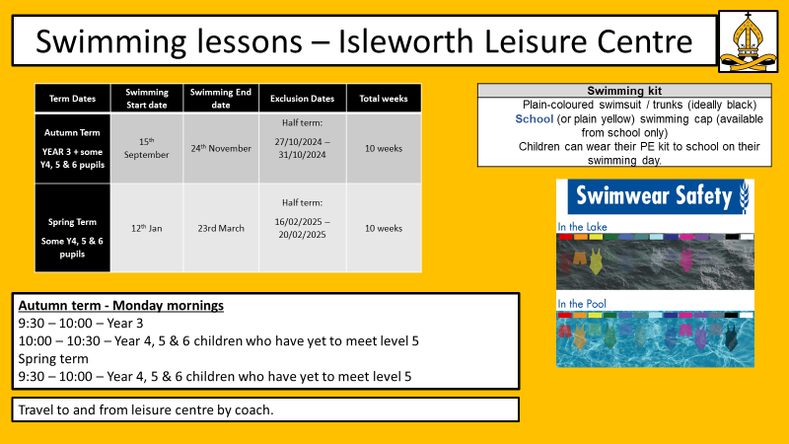

Swimming lessons – Isleworth Leisure Centre
Term Dates | Swimming Start date | Swimming End date | Exclusion Dates | Total weeks
Autumn Term All of YEAR 3 + some Y5 & 6 pupils | 23rd September | 3rd December | Half term: 28/10/2024 – 01/11/2024 | 10 weeks
Spring Term All of YEAR 2 + some Y4, 5 & 6 pupils | 13th Jan | ^{17th} March | Half term: 17/02/2025 – 21/02/2025 | 10 weeks
Swimming kit
Plain-coloured swimsuit / trunks (ideally black) School (or plain yellow) swimming cap (available from school only) Children can wear their PE kit to school on their swimming day.
Autumn term - Monday mornings
9:30 – 10:00 – Year 3
10:00 – 10:30 – Year 5 & 6 children who have yet to meet level 5
Spring term
9:30 – 10:00 – Year 2
10:00 – 10:30 – Year 4, 5 & 6 children who have yet to meet level 5
Letters will go out to families early this week, currently finalising coach costs.
Travel to and from leisure centre by coach.
Notes:
Uniform policy

Slide 12
Homework
Homework is important in consolidating learning undertaken in school and extending children’s understanding. Please ensure that your child completes any homework tasks set.
Year 3 Homework
Weekly tasks will be 5 x readings, a grammar or reading comprehension activity (alternate weeks); Mathletics tasks and times tables to learn including using Times Tables Rock Stars.
All homework is set on Monday and will be collected in on the following Monday.
We no longer be sending home lists of spellings to be learnt for a test at the end of the week. We are currently investigating an online alternative.
Children should practise reading at home with an adult or older sibling at least five times a week for about 10 minutes each time. Readings should be recorded in their homework diary.

Slide 13
Behaviour
Children are expected to follow the Bishop Perrin 5 Bs at all times, this includes listening and not talking when an adult is talking and stopping their activity when asked. Children who consistently do not follow these expectations may lose part of their play or lunch time. Children who have not finished their work after ample opportunity may also be asked to stay in at lunch to complete it.
Children are encouraged to use the bathroom during registration, the Daily Mile, break time or lunch time. Children who are desperate for the toilet outside of these times will be allowed to go but this is limited to one child at a time. Children who are going to the toilet during lesson time are missing out on their learning and can be disruptive to the rest of the class so this is not encouraged. If children ask to go to the toilet close to a break time, they will be encouraged to remain in class and wait. If children are consistently using the toilet during lesson time and this is seen to be a way of avoiding their work, parents will be contacted.
If your child has a medical reason for needing to use the toilet more regularly, please let me know and they will always be allowed to go when they ask.

Slide 14
Parent Volunteers
Parent volunteers play a valuable role in supporting children with their learning and facilitating wider school experiences. We warmly welcome you to offer your support in whichever way you can.
Some of the ways you can get involved in school life:
Volunteer in class – please contact your child’s class teacher directly to discuss ways in which you can help and to arrange a suitable time to come in
Contact the school office to volunteer as a weekly volunteer to help with children across KS2 with their reading or practising their times tables
Volunteer your time with the School Association. Go along and see what they have planned for the year and how you can help.
Volunteer to help on a school visit. Some up-coming visits for Year 3 include Buster Ancient Farm, Richmond Hill, and Twickenham Stadium Please let your child’s class teacher know if you would like to accompany the class on these visits.
Volunteer to help to walk to church / library with your child’s class

Slide 15
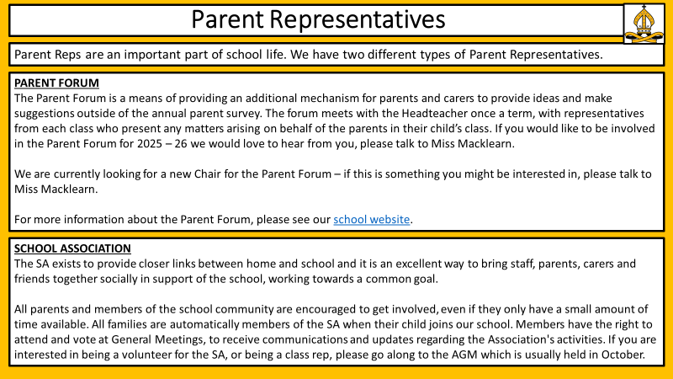

Slide 16
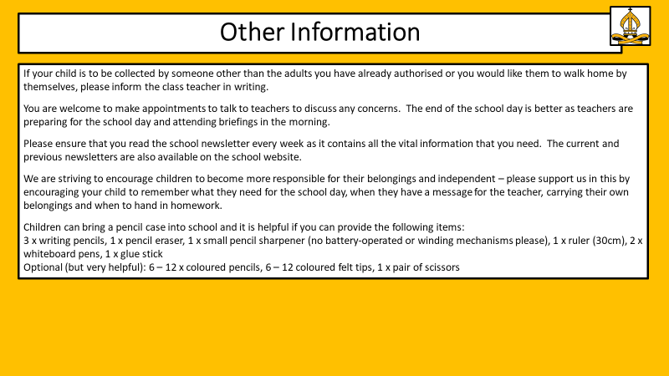
Other Information
If your child is to be collected by someone other than the adults you have already authorised or you would like them to walk home by themselves, please inform the class teacher in writing.
You are welcome to make appointments to talk to teachers to discuss any concerns. The end of the school day is better as teachers are preparing for the school day and attending briefings in the morning.
Please ensure that you read the school newsletter every week as it contains all the vital information that you need. The current and previous newsletters are also available on the school website.
We are striving to encourage children to become more responsible for their belongings and independent – please support us in this by encouraging your child to remember what they need for the school day, when they have a message for the teacher, carrying their own belongings and when to hand in homework.
Children can bring a pencil case into school and it is helpful if you can provide the following items:
3 x writing pencils, 1 x pencil eraser, 1 x small pencil sharpener (no battery-operated or winding mechanisms please), 1 x ruler (30cm), 2 x whiteboard pens, 1 x glue stick
Optional (but very helpful): 6 – 12 x coloured pencils, 6 – 12 coloured felt tips, 1 x pair of scissors

Slide 17
Useful Sites to Support Learning
https://login.mathletics.com/
https://www.purplemash.com/login/
https://www.bbc.co.uk/bitesize/primary
https://www.thenational.academy/

