Slide 1

BISHOP PERRIN PRIMARY SCHOOL
Celebrating learning together in faith, hope and love
PARENT INFORMATION MEETING
September 2025

Slide 2
School Vision
Our vision is that we will grow in the God-given virtues of “faith, hope and love” (1 Corinthians 13:13): having faith in God or being inspired by faith; having hope that we can work to change ourselves and the world for the better; and having love for others, reflecting God’s love for everyone.

Slide 3
Curriculum Statement
Inspired by our local community and surroundings, our curriculum at Bishop Perrin School is designed to nurture life-long learners and provide opportunities for all to succeed in the modern world with confidence, creativity and curiosity. We endeavour to instil a love of learning using a range of exciting and inspiring books as a gateway to a wide range of subjects and cultural and social experiences. We aim to provide opportunities for all pupils to learn the knowledge, understanding and interpersonal skills necessary to be active, healthy, responsible participants in their community and the wider world, providing stable foundations for the next stage in their learning. Our curriculum is underpinned by our school’s spiritual values.

Slide 4
We value the support from parents and the partnership between home and school which ensures that children are able to be the best they can during their time at Bishop Perrin School. This meeting is designed to assist your child and the smooth running and work of the school throughout this academic year, and supports our Home School Agreement.
Further information is available on our school website: www.bishopperrin.richmond.sch.uk
Please follow us on our instagram account where you can keep up-to-date with the latest goings-on at school. Follow us on: @bishopperrinschool
Partnership between home and school

Slide 5
Attendance
Your child should be in school every day unless they are unwell. The school must be informed of any absence.
Holidays during term time are not permitted and are strongly discouraged. Whilst we understand the challenges facing families regarding cost of holidays, term-time holidays are very disruptive for children in school and result in a significant loss of learning. Term-time holidays will be recorded as an unauthorised absence and may be subject to a fine.
Children are awarded certificates at the end of each term for excellent attendance – 98% or above with no unauthorised absences.
Pick up at the end of the day
Pick up time is at 3:15pm, from the playground. Please ensure we have written permission for any adults who you allow to pick your child up from school at the end of the day. If your child is to be collected by someone other than the adults you have already authorised, please inform the school in writing.
Some Year 6 children walk home or meet parents outside school; please ensure we have written permission if you would like your child to leave school by themselves or if they are to be picked up by someone who is not on their named collection list.
Punctuality
It is imperative that your child arrives at school on time to support a settled and smooth transition to the start of the school day.
The front gate will be open from 8:30am until 8:40am. Your child is expected to arrive at school before the gate closes. This time is often used for interventions and lots of the children in Year 6 have responsibilities/jobs that are completed in this time so please make sure that they arrive as close to 8.30 as possible.
If your child arrives after 8:40am, please bring them to the main entrance and sign them in using the electronic register.
Attendance and Punctuality

Slide 6
Adherence to the school uniform policy is greatly appreciated in ensuring we maintain a smart and unified approach to school uniform.
All children should be smartly dressed in the school uniform – the policy is available on the school website. Children are expected to wear school shoes, not trainers.
All items must be clearly named.
PE Kit
Please ensure that your child has their house t-shirt, PE jumper, tracksuits/shorts and/or black tracksuit trousers/top. Pupils come in to school on PE days in their PE kit. Swimming kit – ideally black swim suit or swimming trunks. In Year 6 their PE days are on Monday and Thursday.
Outer wear
School fleece or a dark-coloured coat. Hats and scarves must be plain and dark in colour.
Accessories
Jewellery is not permitted, except for a simple pair of stud earrings for children who have pierced ears, and a wrist watch. Fit bits are permitted, but no other smart watch devices in-line with our online safety policy.
Water bottles
Children are encouraged to bring a small, plastic water bottle into school. Only water is permitted for drinking in school. Please do not send metal water bottles or over-sized / expensive water bottles. Water bottles MUST be named. This is not just to help identify who the bottle belongs to, but is also a strategy for managing risk involving food allergies.
School Uniform

Slide 7
Behaviour
Children are expected to follow the Bishop Perrin 5 Bs at all times, this includes listening and not talking when an adult is talking and stopping their activity when asked. Children who consistently do not follow these expectations may lose part of their play or lunch time. Children who have not finished their work after ample opportunity may also be asked to stay in at lunch to complete it.
Children are encouraged to use the bathroom during registration, the Daily Mile, break time or lunch time. Children who are desperate for the toilet outside of these times will be allowed to go but this is limited to one child at a time. Children who are going to the toilet during lesson time are missing out on their learning and can be disruptive to the rest of the class so this is not encouraged. If children ask to go to the toilet close to a break time, they will be encouraged to remain in class and wait. If children are consistently using the toilet during lesson time and this is seen to be a way of avoiding their work, parents will be contacted.
If your child has a medical reason for needing to use the toilet more regularly, please let me know and they will always be allowed to go when they ask.

Slide 8
Mobile phones in school
Mobile phones and smart watches are not allowed in school.
However, we understand that when children are walking to and from school, it is reassuring for them to have a mobile phone with them. Children on the walk to school / walk home register can bring a mobile phone to school but it is entirely at their own risk. This must not be a smartphone.
Phones must be turned off on arrival at school before the children go down the pathway into the school playground, and the phone must remain switched off and in the children’s bag in their locker for the rest of the day until the child has left the school premises. We should not see or hear these phones for the duration of the school day.
If children are found not to be adhering to these rules, the phone will be confiscated and parents will be asked to collect it at the end of the day. It is unlikely the child will be able to continue to bring their phone into school again if this happens. Phones are the children’s responsibility during the day and are to be kept in school bags in their locker.
This system has worked for a number of years, relying on the trust and responsibility we expect from the children to adhere to the rules and not take advantage of the privilege of being able to bring one to school.
The school does not accept any responsibility for any damage or if a phone goes missing.

Slide 9
Reading
Teachers regularly assess children’s reading to ensure that they are reading at the correct level.
Children will bring home their reading practise book (book bands) which will be their weekly reading homework. These readings should be recorded in their homework diary, along with a note of any challenging vocabulary. Children should be heard read at home by an adult or older sibling at least five times a week for about 20 minutes each time.
They will also have a ‘reading for pleasure’ book from the library. This is a book of their choice and is designed to be read to them by an adult or read independently to encourage an enjoyment of reading.
For children who have completed reading all the reading practise books (final level – Pearl), they will become an independent reader and their books can be from the library or brought from home.
Reading books/ homework diaries should be in school every day and are changed when the child has finished their book as long as the homework diary has been signed by a parent/guardian.
For this half term, we are reading Wind in the Willows by Kenneth Grahame.
We will start our work with a series of reading lessons, where children are learning how to retrieve information from the text, support their ideas with evidence from the text and use their inference skills.
The children read to the class teacher and teaching assistant 2-3 times a week during Guided Reading.
Some children may need some extra support with their reading so we are making sure that those children read more often. As a parent, it is crucial that you encourage them to read every day when possible.

Slide 10
Handwriting – We encourage neat handwriting presentation to promote a sense of pride in their work which often leads to higher quality content. As children become competent at joined handwriting (from approximately Year 4 onwards), the teacher will encourage them to start writing in pen.
Children will experience reading and writing a range of different texts from stories to recounts to diaries to poems.
Children are encouraged to write more extensively as the year goes on. They are taught grammar and punctuation within the context of the wider writing they are learning.
Spelling – In Year 3, 4, 5 and 6, they learn and apply spelling rules, building upon their phonics knowledge from EYFS and KS1. Children are encouraged to become responsible for spelling words they find tricky by applying strategies they have learnt, correcting mistakes and making use of spelling resources such as word cards and dictionaries.
We do not send home lists of spelling words to learn for a test. Instead, children will receive daily spelling sessions, during which they will be encouraged to review, learn, practise and apply the spelling pattern for the week. They will continue to be assessed regularly, but this will take a different format to a spelling test.
Writing
The children will be undertaking some writing tasks based on Wind in the Willows. As gaps in knowledge of grammar and punctuation become clear, they will be addressed in lessons. Our expectations are that your child will make their expected progress in writing by the end of the year.
Please support your child at home by supporting them if they need help with the Grammar/Punctation homework tasks or revising/practising their current spelling pattern for that week.

Slide 11
At Bishop Perrin, Mathematics is taught using a mastery approach so that the skills and knowledge needed are covered in depth and all individuals can succeed. The whole class is taught together with practical resources and support chosen to scaffold or extend the children. Individual learning needs are addressed through scaffolding, skilful questioning and rapid intervention.
High quality feedback and addressing of misconceptions are covered through marking and teacher interaction.
There is lots of opportunity to practise inside and outside of the daily maths lesson to develop fluency and consolidate pupils’ learning. Children are taught fluency in number which is applied in reasoning and problem solving contexts which are accessible to all.
Precise mathematical language and specific vocabulary is modelled and encouraged in children when talking with their peers, giving explanations and recording their ideas.
Maths
Children will be expected to complete their Mathletics homework and learn their times tables at home to help support them with their learning in school.
We will also start weekly arithmetic tests just before half-term.

Slide 12
As well as English and maths, children at Bishop Perrin Primary School also participate in weekly lessons of art, computing, design and technology, French, geography, history, music, PE and science.
Our curriculum is designed to be taught through half-termly themes. Year 6 are currently studying Tales of the Thames. The details for this theme are in the curriculum information sheet which is available on the learning page of the school website.
Foundation Subjects
Foundation subjects are so important for the children in ensuring that they receive a wide and balanced curriculum. All foundation subjects will cover the objectives set for that term, in some cases combining learning objectives so that full coverage is achieved.
Please support your child at home by encouraging them to research current topics and where possible, look at books linked to the current theme.

Slide 13

Swimming lessons – Isleworth Leisure Centre
Term Dates | Swimming Start date | Swimming End date | Exclusion Dates | Total weeks
Autumn Term YEAR 3 + some Y4, 5 & 6 pupils | 15th September | 24th November | Half term: 27/10/2024 – 31/10/2024 | 10 weeks
Spring Term Some Y4, 5 & 6 pupils | 12th Jan | 23rd March | Half term: 16/02/2025 – 20/02/2025 | 10 weeks
Swimming kit
Plain-coloured swimsuit / trunks (ideally black) School (or plain yellow) swimming cap (available from school only) Children can wear their PE kit to school on their swimming day.
Autumn term - Monday mornings
9:30 – 10:00 – Year 3
10:00 – 10:30 – Year 4, 5 & 6 children who have yet to meet level 5
Spring term
9:30 – 10:00 – Year 4, 5 & 6 children who have yet to meet level 5
Travel to and from leisure centre by coach.
Notes:
Uniform policy

Slide 14
Year 6 SATs usually take place in early/mid May.
The tests are:
1 Reading test
1 Spelling, Punctuation and Grammar test (SPAG test)
1 Arithmetic test
2 Maths Reasoning tests
Writing – assessed by the teacher from independent writing tasks
The children will be well prepared for these tests – we carry out practise tests throughout the year.
Should your child be assessed as being allowed extra time for completing the tests, we will let you know.
Year 6 SATs

Slide 15
Homework
Homework is important in consolidating learning undertaken in school and extending children’s understanding. Please ensure that your child completes any homework tasks set.
Year 6 Homework
Weekly tasks will be 5 x readings, a grammar or reading comprehension activity (alternate weeks); Mathletics tasks and times tables to learn.
All homework (apart from spelling) is set on Monday and will be collected in on the following Monday.
Children will also receive weekly spellings to learn on a Friday – spelling tests will be on the following Friday.
Children should be heard read at home by an adult or older sibling at least five times a week for about 10 minutes each time.
Homework is important in consolidating learning undertaken in school and extending children’s understanding. Please ensure that your child completes any homework tasks set.
Year 6 Homework
Weekly tasks will be 5 x readings (20 mins), a grammar or reading comprehension activity (alternate weeks); Mathletics tasks (20 mins minimum) and times tables to learn if needed.
All homework is set on Tuesday and will be collected in on the following Tuesday. There will be a spelling test every Friday.
Children should practise reading at home with an adult or older sibling or read to themselves at least five times a week for about 20 minutes each time. Readings should be recorded in their homework diary.

Slide 16
For the Year 6 School Journey, we are going back to Bowles Activity Centre (located near Tunbridge Wells). Last year’s Year 6 had an amazing time there in the summer term and we are looking forward to returning there this year. The week is an activities based course that enables the children to partake in adventurous activities that we cannot provide in school such as abseiling, climbing, archery, rifle shooting and other team building and initiative activities.
You can find out more information about the centre by visiting their website: https://bowles.rocks/
The date for the trip is Monday 22nd-Friday 26th June 2026 and you have received the initial letter.
Hardship: If you are in receipt of Free School Meals, Income Support or Job Seekers Allowance you may be eligible for assistance with the cost of this trip. Please contact the office if you need advice about payment.
Year 6 School Journey

Slide 17
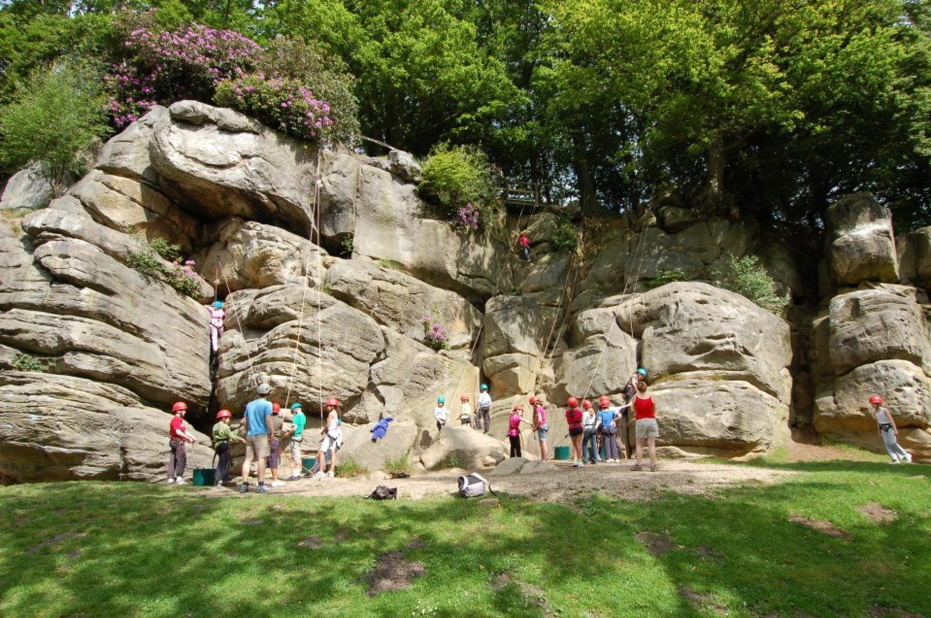
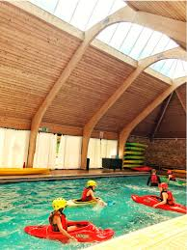
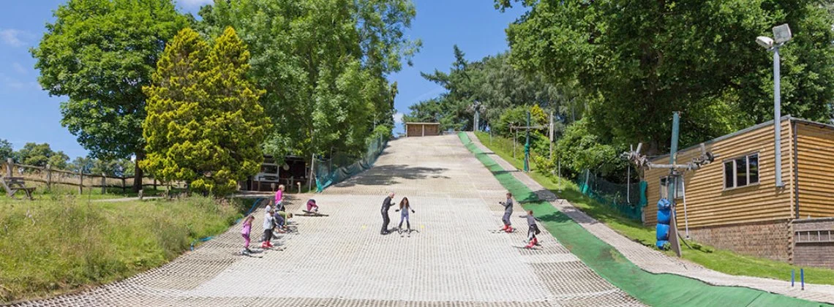
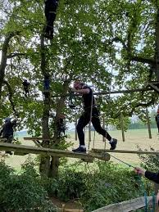

Slide 18
Parent Volunteers
Parent volunteers play a valuable role in supporting children with their learning and facilitating wider school experiences. We warmly welcome you to offer your support in whichever way you can.
Some of the ways you can get involved in school life:
Volunteer in class – please contact your child’s class teacher directly to discuss ways in which you can help and to arrange a suitable time to come in
Contact the school office to volunteer as a weekly volunteer to help with children across KS2 with their reading or practising their times tables
Volunteer your time with the School Association. Go along and see what they have planned for the year and how you can help.
Volunteer to help on a school trip.

Slide 19
Parent Representatives
Parent Reps are an important part of school life. We have two different types of Parent Representatives.
PARENT FORUM
The Parent Forum is a means of providing an additional mechanism for parents and carers to provide ideas and make suggestions outside of the annual parent survey. The forum meets with the Headteacher once a term, with representatives from each class who present any matters arising on behalf of the parents in their child’s class. If you would like to be involved in the Parent Forum for 2025 – 26 we would love to hear from you, please talk to Miss Macklearn.
We are currently looking for a new Chair for the Parent Forum – if this is something you might be interested in, please talk to Miss Macklearn.
For more information about the Parent Forum, please see our school website.
SCHOOL ASSOCIATION
The SA exists to provide closer links between home and school and it is an excellent way to bring staff, parents, carers and friends together socially in support of the school, working towards a common goal.
All parents and members of the school community are encouraged to get involved, even if they only have a small amount of time available. All families are automatically members of the SA when their child joins our school. Members have the right to attend and vote at General Meetings, to receive communications and updates regarding the Association's activities. If you are interested in being a volunteer for the SA, or being a class rep, please go along to the AGM which is usually held in October.

Slide 20
Other Information
If your child is to be collected by someone other than the adults you have already authorised or you would like them to walk home by themselves, please inform the class teacher in writing.
You are welcome to make appointments to talk to teachers to discuss any concerns. The end of the school day is better as teachers are preparing for the school day and attending briefings in the morning.
Please ensure that you read the school newsletter every week as it contains all the vital information that you need. The current and previous newsletters are also available on the school website.
We are striving to encourage children to become more responsible for their belongings and independent – please support us in this by encouraging your child to remember what they need for the school day, when they have a message for the teacher, carrying their own belongings and when to hand in homework.
Children can bring a pencil case into school and it is helpful if you can provide the following items:
3 x writing pencils, 1 x pencil eraser, 1 x small pencil sharpener (no battery-operated or winding mechanisms please), 1 x ruler (30cm), 2 x whiteboard pens, 1 x glue stick
Optional (but very helpful): 6 – 12 x coloured pencils, 6 – 12 coloured felt tips, 1 x pair of scissors

Slide 21
Useful Sites to Support Learning
https://login.mathletics.com/
https://www.purplemash.com/login/
https://www.bbc.co.uk/bitesize/primary
https://www.thenational.academy/

